Slide 1

Heuristic Search Algorithm
(Informed Search)
Artificial Intelligence
Faculty of Computing
Universiti Teknologi Malaysia
Notes:
https://www.sciencedirect.com/book/9780123725127/heuristic-search#book-description
https://www.sciencedirect.com/topics/computer-science/heuristic-search-algorithm

Slide 2
Outline
What is Heuristic Search?
Selection of a Search Strategy
Hill climbing Search
Best-first Search
Search with Heuristic
Comparison of all search strategy
Heuristic Evaluation Function f(n)
Exercise
Notes:
https://data-flair.training/blogs/heuristic-search-ai/

Slide 3
What is Heuristic Search?
Definition
Taxonomy of Heuristic Search

Slide 4
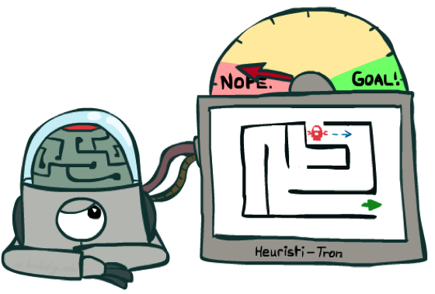
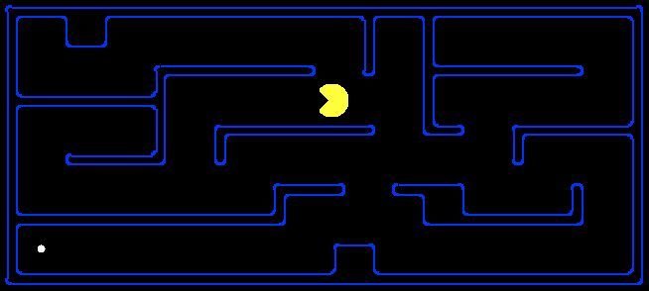
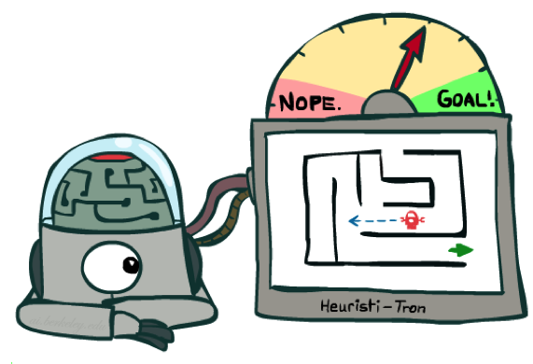
Heuristic Search: Definition
A heuristic is:
A function that estimates how close a state is to a goal
Designed for a particular search problem
Examples: Manhattan distance, Euclidean distance for path
10
5
11.2

Slide 5
Heuristic Search: Definition
A technique to solve a problem faster than classic methods, or to find an approximate solution when classic methods cannot.
Heuristic is a rule of thumb that probably leads to a solution. Heuristics play a major role in search strategies because of exponential nature of the most problems. Heuristics help to reduce the number of alternatives from an exponential number to a polynomial number
This is a kind of a shortcut as we often trade one of optimality, completeness, accuracy, or precision for speed.
A Heuristic (or a heuristic function) takes a look at search algorithms. At each branching step, it evaluates the available information and makes a decision on which branch to follow. It does so by ranking alternatives. The Heuristic is any device that is often effective but will not guarantee work in every case.

Slide 6
Heuristic Search: Definition
(rules of thumb): Weak search method because it is based on experience or intuition.
Have long been a core concern in AI research
Used to prune spaces of possible solution
When to employ Heuristic?
A problem may not have an exact solution.
e.g. medical diagnosis: doctors use heuristic
A problem may have an exact solution, but the computational cost of finding it may be prohibitive.
e.g in chess (exhaustive or brute force search)

Slide 7
Weak Heuristic Search
Hill climbing Search
Best-first Search
A* Search

Slide 8
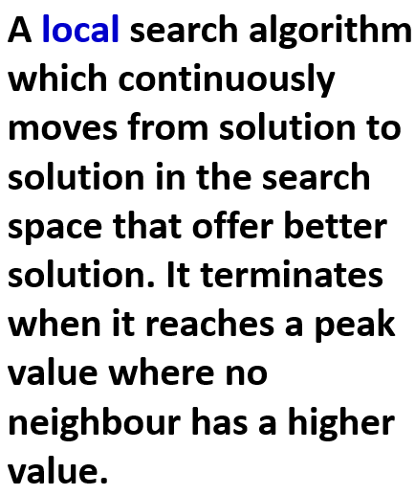
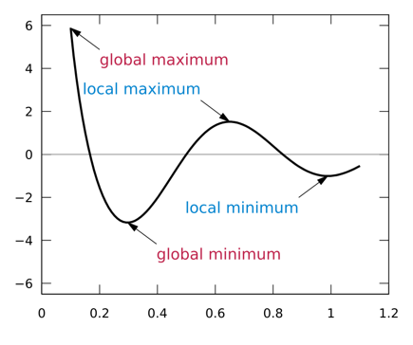
Hill Climbing

Slide 9
Hill Climbing: Type
It examines the neighboring nodes one by one and selects the first neighboring node which optimizes the current cost as next node.
Simple Hill climbing
Steepest-Ascent Hill climbing
It first examines all the neighboring nodes and then selects the node closest to the solution state as of next node.
It does not examine all the neighboring nodes before deciding which node to select .It just selects a neighboring node at random and decides (based on the amount of improvement in that neighbor) whether to move to that neighbor or to examine another.
Stochastic hill climbing

Slide 10
Hill Climbing: Issues
All neighboring states have values worse than the current. The greedy approach means we won’t be moving to a worse state. This terminates the process even though there may have been a better solution. As a workaround, we use backtracking.
Local Maximum
All neighbors to it have the same value. This makes it impossible to choose a direction. To avoid this, we randomly make a big jump.
Plateau
At a ridge, movement in all possible directions is downward. This makes it look like a peak and terminates the process. To avoid this, we may use two or more rules before testing.
Ridge

Slide 11
Best First Search
It is a general algorithm for heuristically searching any state space graph
Supports a variety of heuristic evaluation functions
Better and flexible Algorithm for heuristic search
Avoid local maxima, dead ends; has open and close lists
selects the most promising state
apply heuristic and sort the ‘best’ next state in front of the list ( priority queue ) can jump to any level of the state space
If lead to incorrect path, it may retrieve the next best state

Slide 12
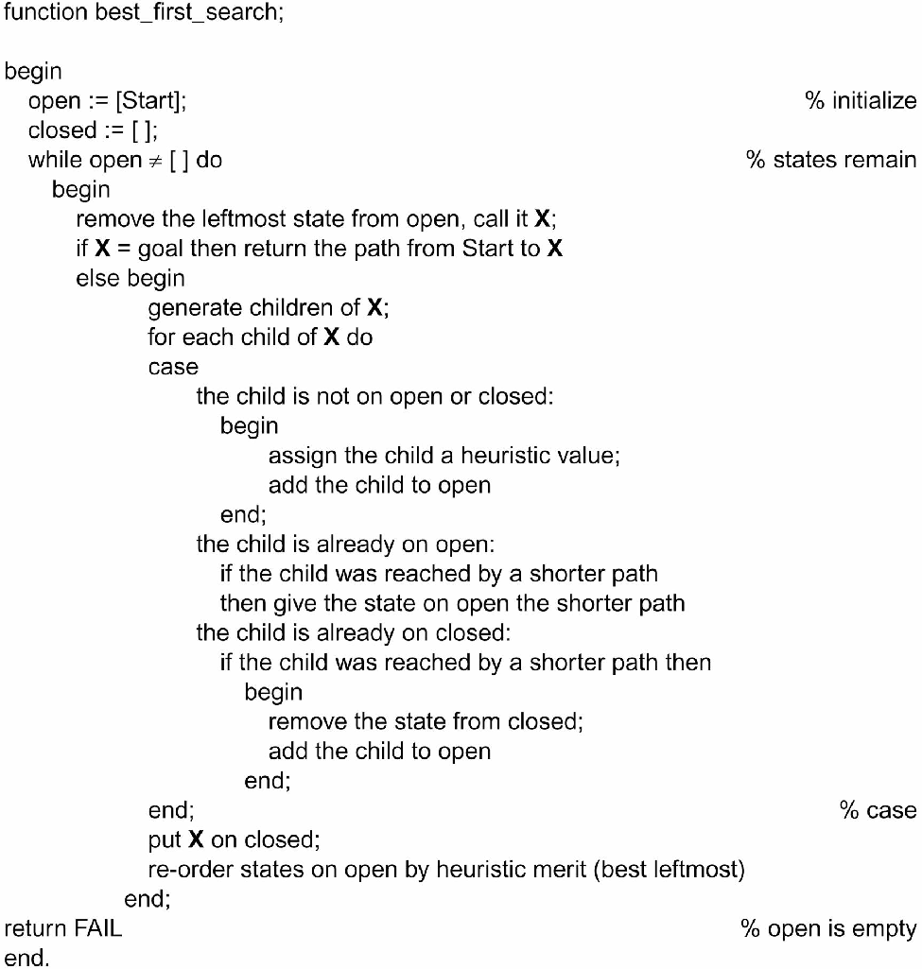
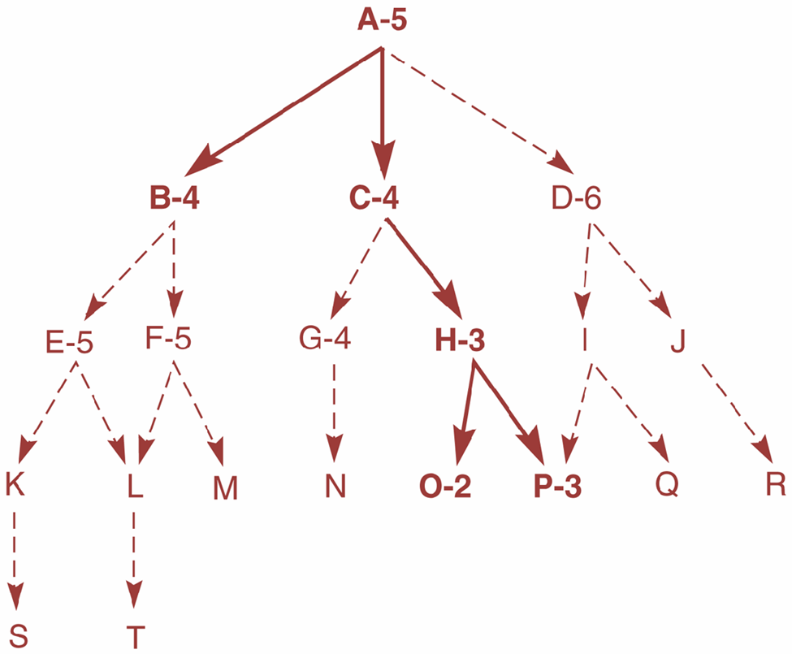
Best First Search

Slide 13
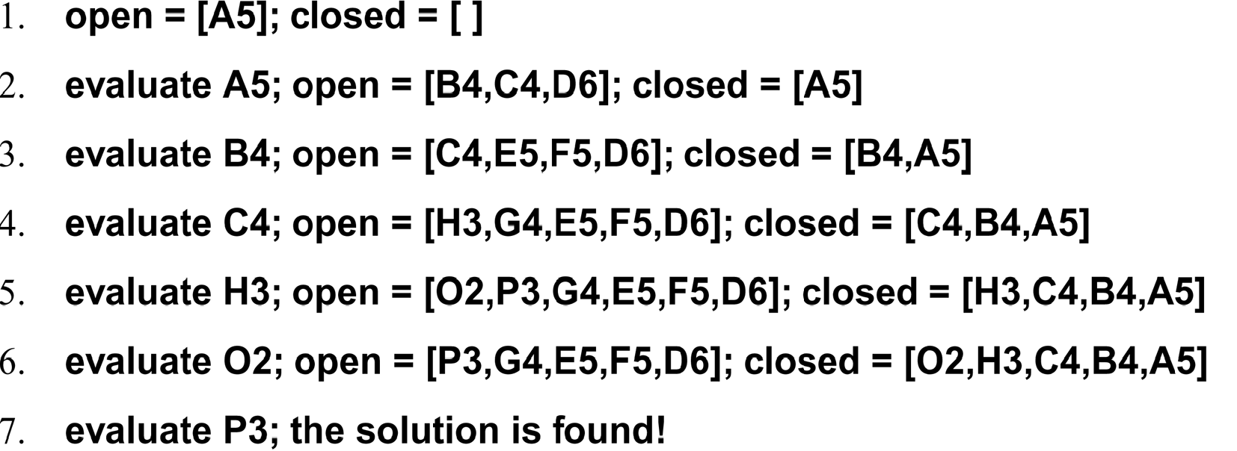
Best First Search

Slide 14
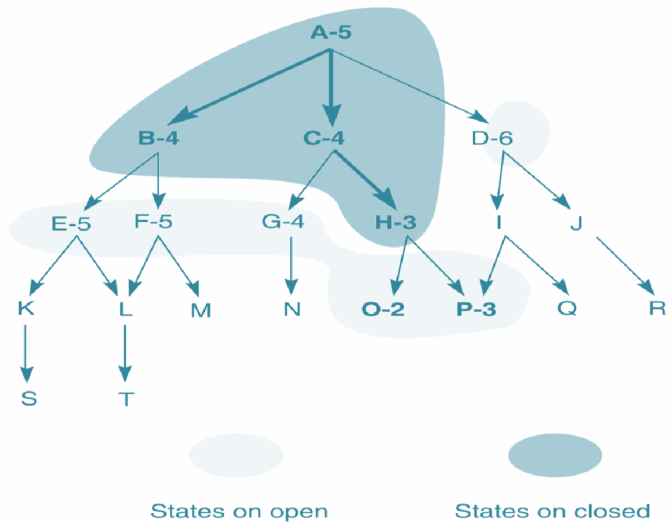
Best First Search
Heuristic search of a hypothetical state space with open and closed states highlighted.

Slide 15
A* Search
What is A* Search Algorithm?
A* Search algorithm is one of the best and popular technique used in path-finding and graph traversals.
Why A* Search Algorithm?
Informally speaking, A* Search algorithms, unlike other traversal techniques, it has “brains”. What it means is that it is really a smart algorithm which separates it from the other conventional algorithms.
Many games and web-based maps use this algorithm to find the shortest path very efficiently (approximation).
Notes:
https://www.geeksforgeeks.org/a-search-algorithm/

Slide 16
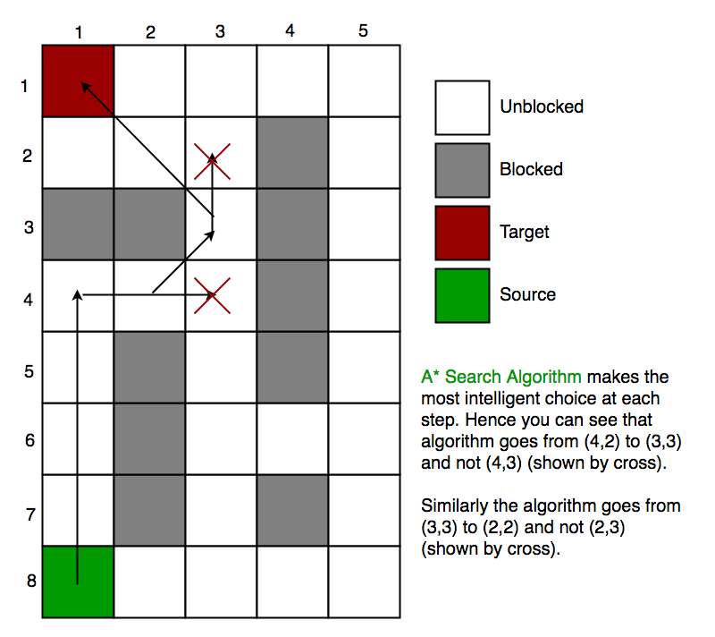
A* Search
Approximation Heuristics
There are generally three approximation heuristics to calculate h
Manhattan Distance
Diagonal Distance
Euclidean Distance
Notes:
https://www.geeksforgeeks.org/a-search-algorithm/

Slide 17
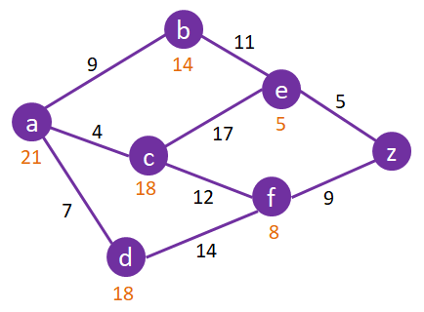
A* Search
What is the shortest path to travel from a to z?

Slide 18
Heuristic Evaluation Function f(n)

Slide 19
Heuristic Evaluation Function f(n)
To evaluate performances of heuristics for solving a problem
Devise good heuristic using limited information to make intelligent choices
To better heuristic, f(n)=g(n)+h(n), where g(n) distance from start to n, h(n) is distance from n to goal
Eg. 8 puzzle, heuristics h(n) could be:
No. of tiles in wrong position
No. of tiles in correct position
Number of direct reversal (2X)
Sum of distances out of place
And g(n) is the depth measure

Slide 20
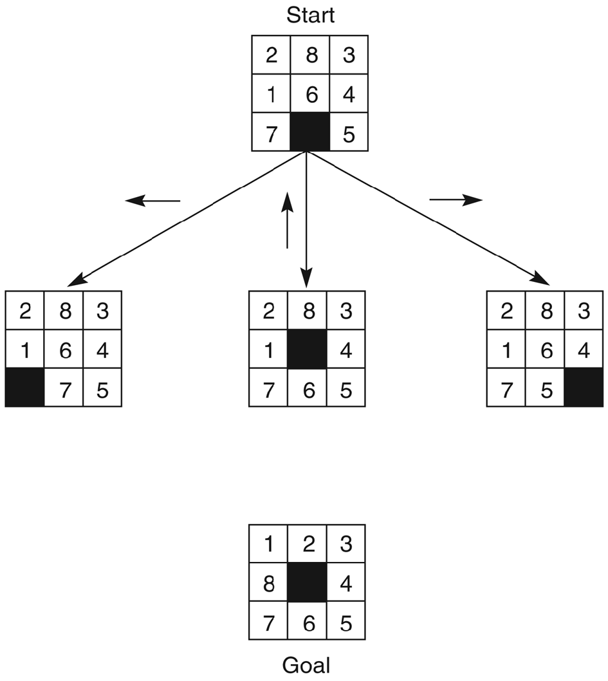
Heuristic Evaluation Function f(n)
The start state, first set of moves, and goal state for an 8-puzzle instance.
f(n) = g(n) + h(n)
g(n) = actual dist. from start to n
h(n) = no. of tiles in wrong position
g(n)=0
g(n)=1

Slide 21
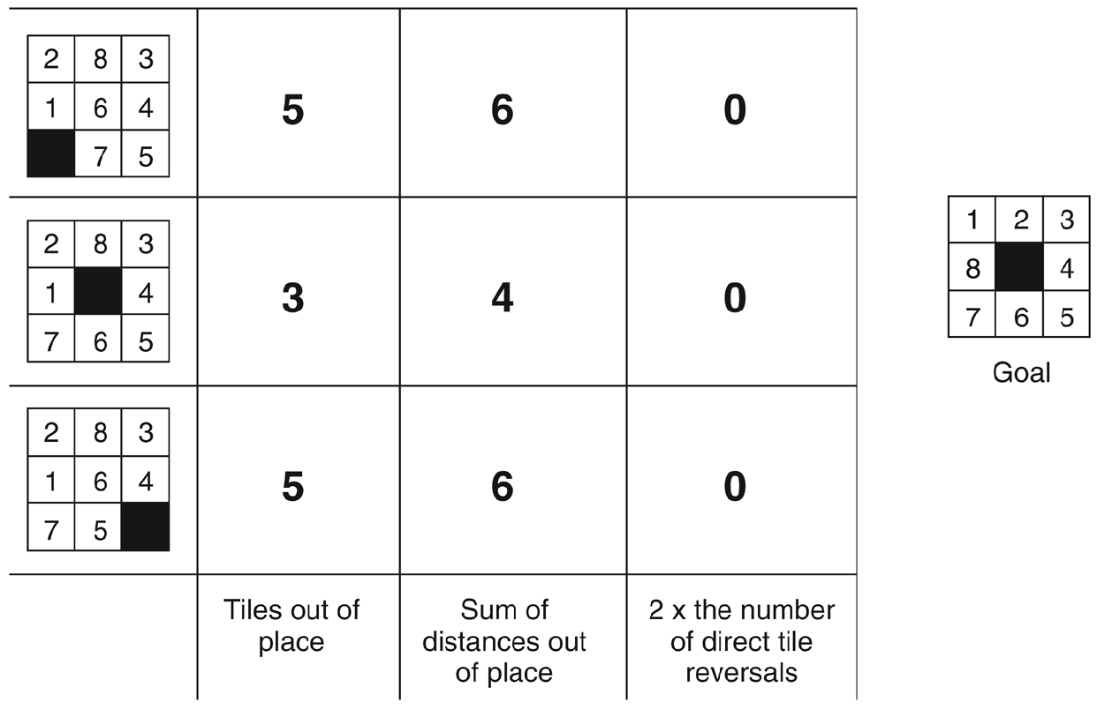
Activity: Heuristic Evaluation Function f(n)
Three heuristics applied to states in the 8 puzzle
Devising good heuristics is sometimes difficult; OUR GOAL is to use the limited information available to make INTELLIGENT CHOICE
Use formula as follows:
f(n) = g(n) + h(n)
g(n) = actual dist. from n to start
h(n) = no. of tiles in wrong position
g(n) = ?
?
?
?
?
g(n) = ?
g(n) = ?
?
?
h(n)
f(n)

Slide 22
Heuristic Evaluation Function f(n)
Three heuristics applied to states in the 8 puzzle
Devising good heuristics is sometimes difficult; OUR GOAL is to use the limited information available to make INTELLIGENT CHOICE
Use formula as follows:
f(n) = g(n) + h(n)
g(n) = actual dist. From n to start
h(n) = no. of tiles in wrong position
g(n) = 1
g(n) = 2
g(n) = 3
h(n)
f(n)

Slide 23
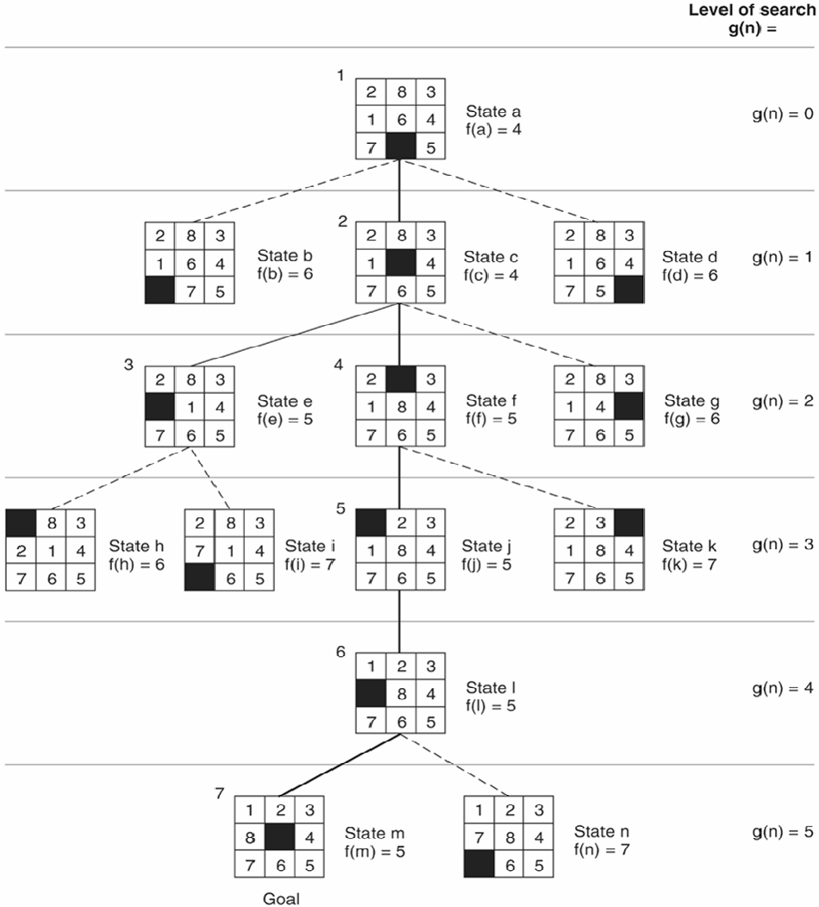
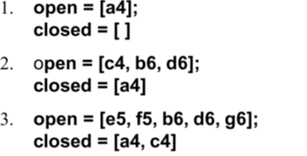
Activity: Open & Closed states
In the tree of 8 puzzle given in the next slide, Give the value of f(n) for each state, based on g(n) and h(n)
Trace using best first search, what will be the lists of open and closed states? Complete the lists below until successfully achieving the goal.
f(n) = g(n) + h(n)
g(n) = actual dist. from n to start
h(n) = no. of tiles in wrong position

Slide 24
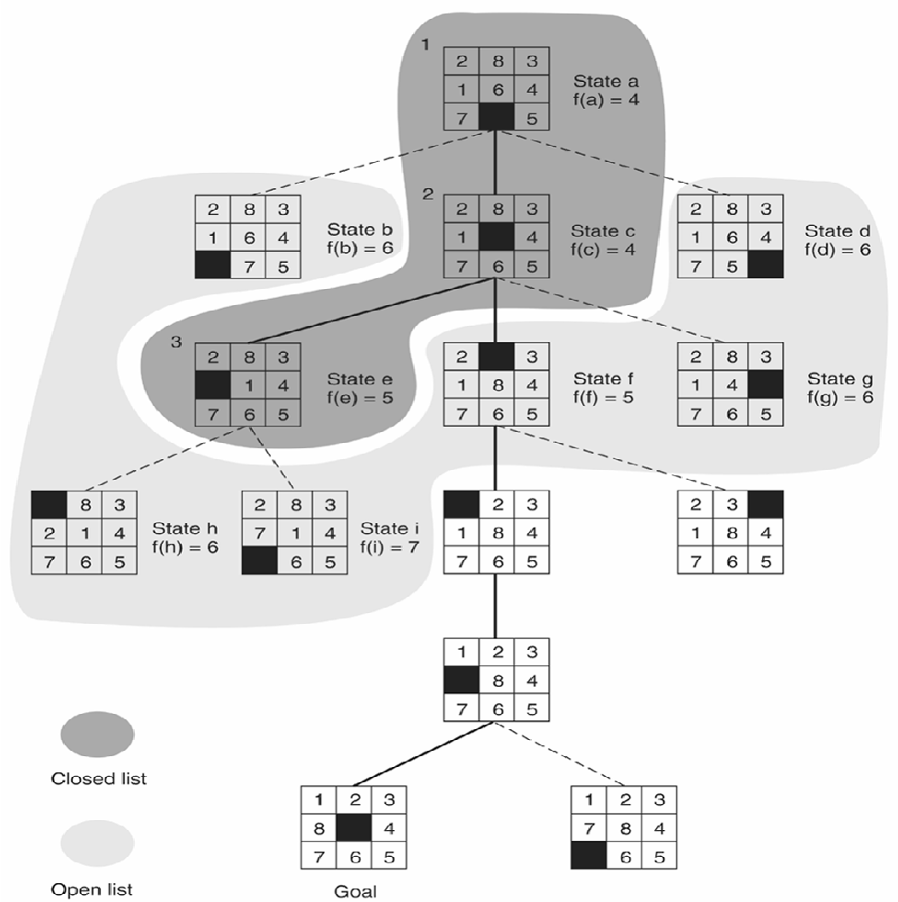
Activity: Evaluate f(n)
Open and closed as they appear after the third iteration of heuristic search.
Evaluate why from the current state e5, this algorithm moves to f5 but not i7 in the next step.
Notes:
Calculate f(f5) = 3 + 2 = 5
Calculate f(i7) = 4 + 4 = 8
Since f(f5) has a lower value of 5 than i7, thus next is move is to f5

